Slide 1
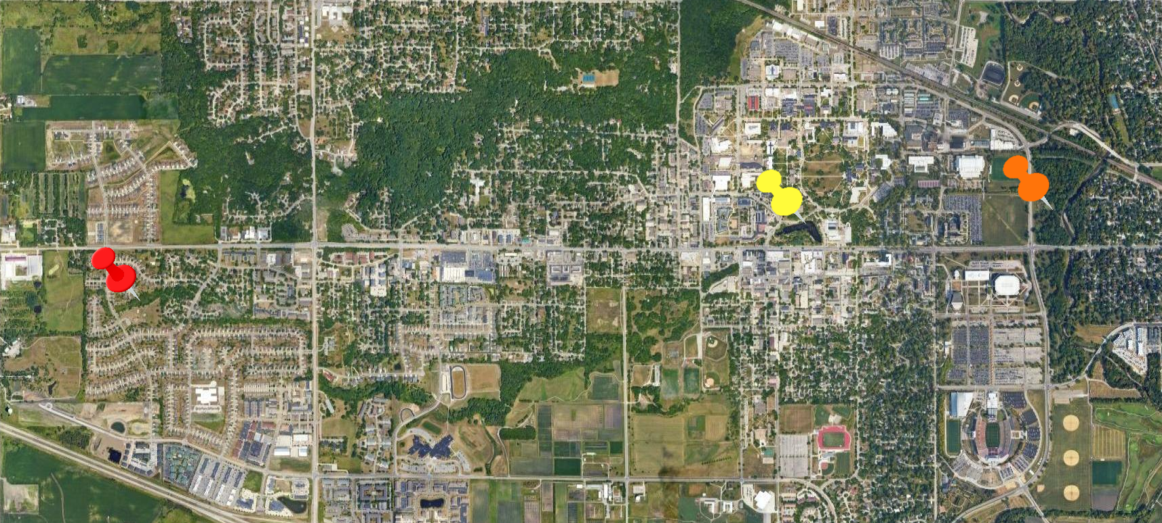
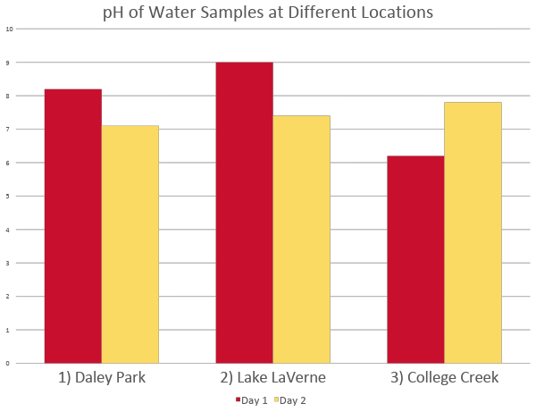
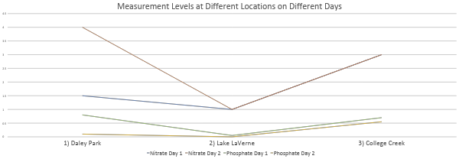

Geology 100L
Fall 2021
IOWA STATE UNIVERSITY
How does campus affect water quality?
Matthew Behnke, Victoria Helvie, Joshua Powell
Research Question
How does Iowa State campus affect the phosphorus, nitrate, and pH levels of
College Creek?
Location 2:
Lake LaVerne
Location 3:
College Creek
Location 1:
Daley Park
Hypothesis
Phosphorous, nitrate, and pH will all be better upstream compared to on
campus and downstream.
Learning Points
Learning about what contaminants are in the water we interact with every day.
Learning how to test the water quality ourselves using indicators and kits.
Evaluating and interpreting the information we obtained through our research.
How campus and other institutions may impact earth.
Methodology
Conclusions
For our research, we collected water samples at Daley Park, Lake LaVerne, and Iowa Creek. The locations chose allow us to see contaminants before, at, and after the water flows through campus. We collected samples on October 25, 2021, and November 12, 2021.
We obtained the samples immediately from the water, caring not to disturb sediments or collect other substances that would possibly affect the outcome.
After collecting the sample, we conducted tests to measure pH levels and nitrate, nitrite, and phosphate content of the water.
This process was repeated at every location in a manner as similarly as possible to the other locations.
For every location, nitrite showed no change at 0, but the other three measurements, pH, nitrate, and Phosphate, all showed change. Samples from locations #1 and #2 showed substantially higher pH levels than the sample taken from location #3.
At locations #1, #3, the phosphate readings were higher than at location #2. The nitrate levels were the highest at locations #3, then #1, and lowest at #2.
The water quality was about the same before and at lake LaVerne but downstream, the water quality lowered, supporting our hypothesis.

